Slide 1
Recognition and prediction of Activity of daily life’s (ADL)
Siddharth Chakravarty

Slide 2
Overview
ADL- What is it?
How is it monitored?
Overview of sensor technology
Problem statement
Approach

Slide 3
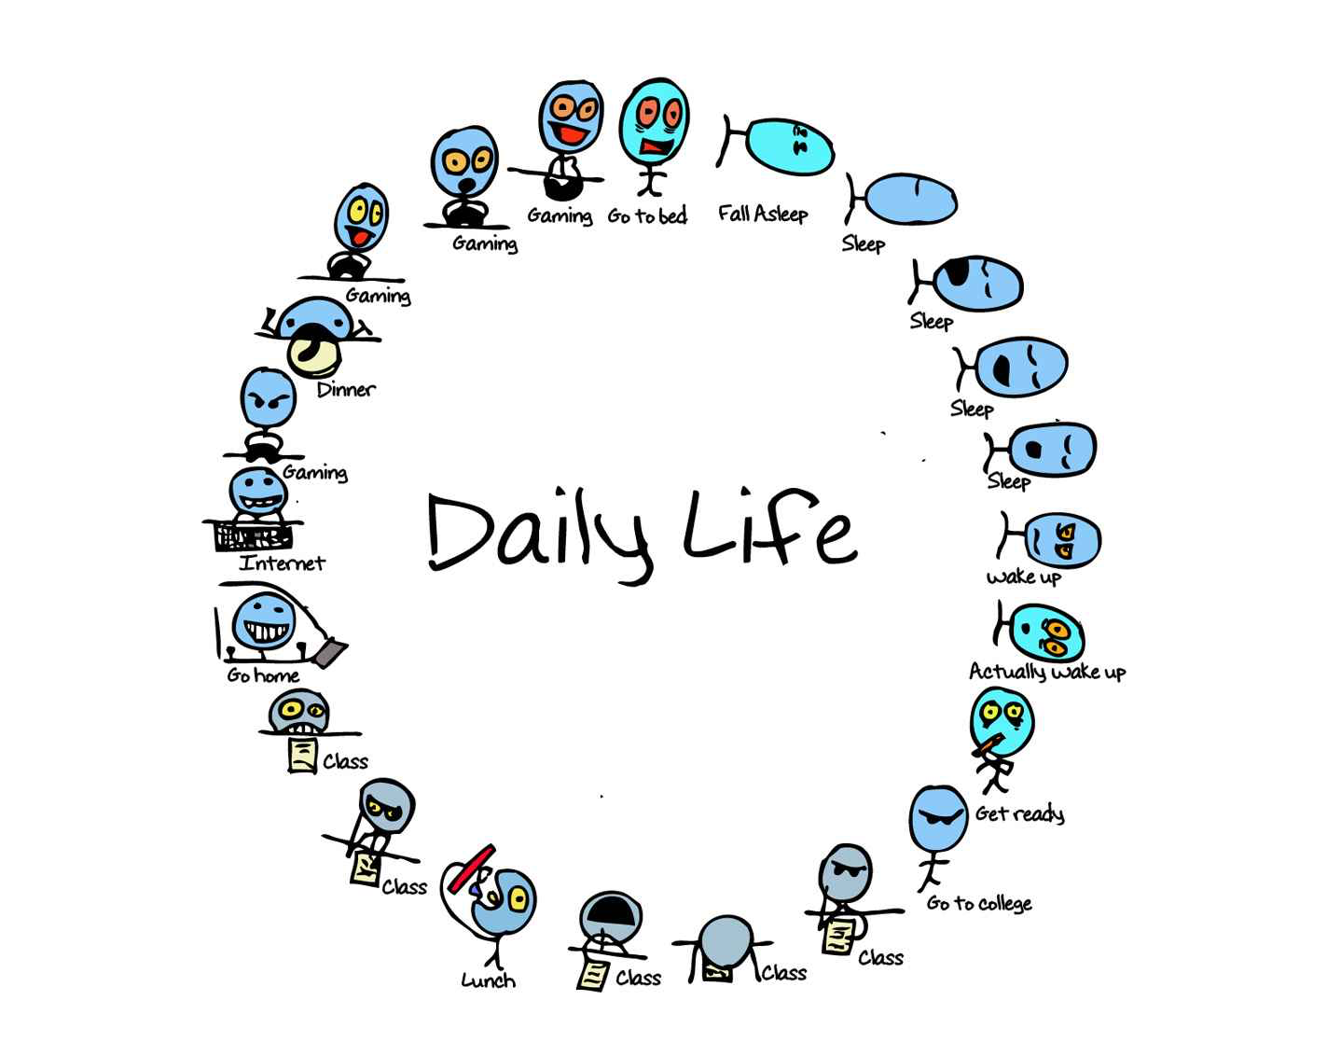
ADL- Activity of Daily life’s
A technique for classification of human activities can be a useful tool to not only classify and monitor our activities, but also improve overall quality of life

Slide 4
What’s out there?
 | Heart rate | Walking | Running | Sleeping | ADL
Heart rate monitors | X
Pedometers | X | X | X
Phone |  | X | X
Wearable | X | X | X | X
Major players
Fitbit - recently announced next generation device
Jawbone- acquired bodymedia to complement it’s technology
Nike
Facebook- acquired Finland-based fitness app maker Protogeo
Microsoft
Samsung
LG
Many more….
Clearly there is a need for accurately monitor ADL’s not just for recreation, but also for other applications.

Slide 5
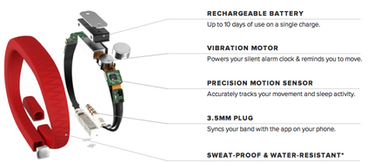
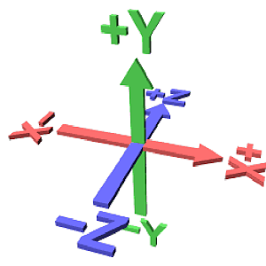
ADL monitoring
Sleeping
Walking
Sweeping
Running
Jumping
Time scale
Accelerometers are the most commonly used type of sensor for activity recognition with wearable sensors and other consumer electronic devices ranging from Iphones to Wii

Slide 6
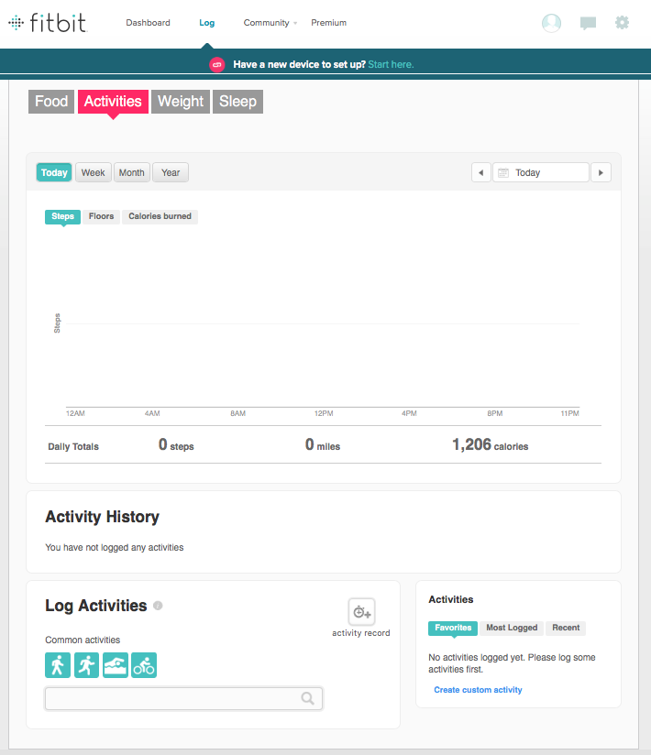
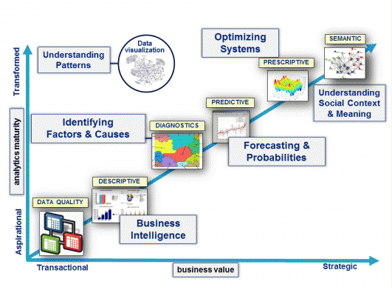
Problem statement
The automatic recognition of a set of Activities of Daily Living, is among the most challenging research fields in Ambient Intelligence.
Main challenge with wearable technology is classification of use case ADL’
Current state of wearable can detect ADL’ such as sleeping, walking and running.
ADI’s such as swimming, cycling etc., have to manually trigged and recorded
The objective of the project is to develop machine learning algorithm that explores SVM and Random forest techniques to build test models and use test sets to predict ADL’.
$Dataset for ADL Recognition with Wrist-worn Accelerometer

